Slide 1
CSE 3207 Mathematical Analysis for Computer Science
S.M. SADAKATUL BARI
Asst. Professor
Dept. Of CSE
BAUST,Saidpur

Slide 2
Course objectives
Modeling of waiting phenomena
Characterization of those phenomena through mathematical models
Evaluation of average system performance
System dimensioning

Slide 3
Lesson Objectives
Review of probability, random variable and its probability distribution

Slide 4
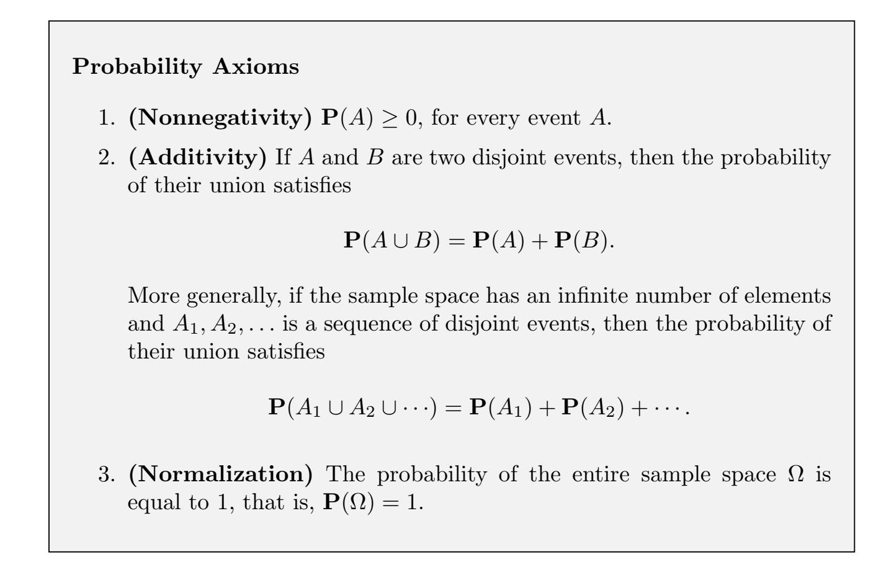
What is Probability?
Science of Uncertainty

Slide 5
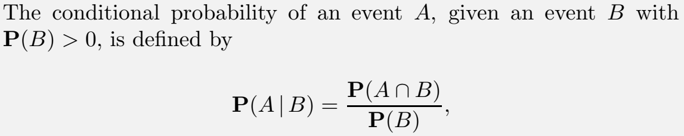
Conditional Probability

Slide 6
Conditional Probability
Def. The conditional probability of E given F is the probability that an event, E, will occur given that another event, F, has occurred
Conditional Probability can be rewritten as follows
if

Slide 7
Conditional Probability
A
B
S

Slide 8
Conditional Probabilitys
Example:
Earned degrees in the United States in recent year

Slide 9
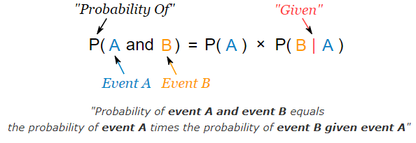
Conditional Probability

Slide 10
Conditional Probability
Example: Ice Cream
70% of your friends like Chocolate, and 35% like Chocolate AND like Strawberry.
What percent of those who like Chocolate also like Strawberry?
P(Strawberry|Chocolate) = P(Chocolate and Strawberry) / P(Chocolate)
=0.35 / 0.7 = 50%
50% of your friends who like Chocolate also like Strawberry

Slide 11
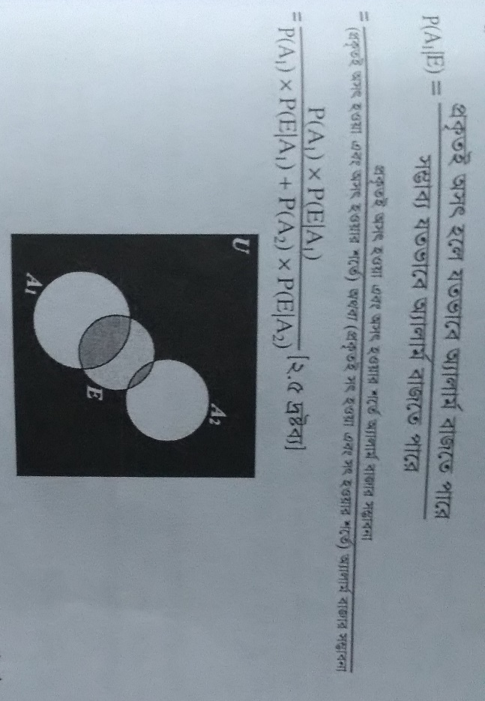
Bayes Theorem

Slide 12
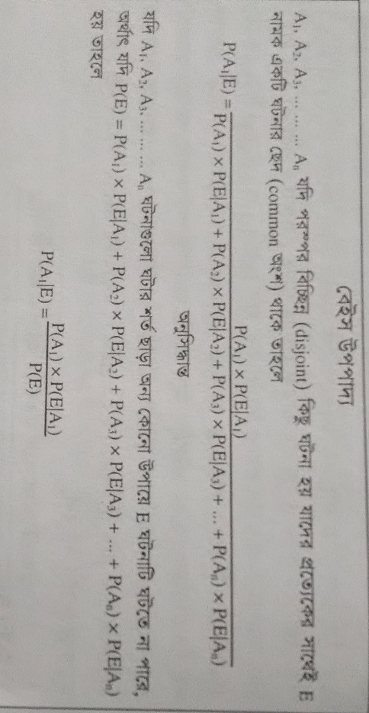
Bayes Theorem

Slide 13
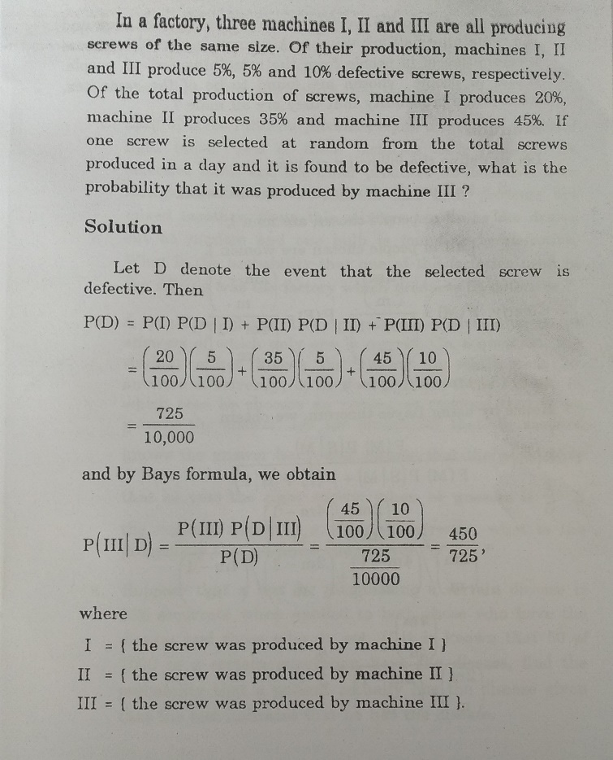
Bayes Theorem Example

Slide 14
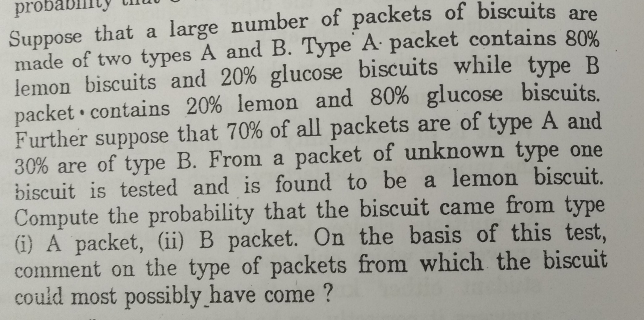
Bayes Theorem Homework/Assignment

Slide 15
Random Variable
A random variable is a rule/function which assigns a numerical value to each possible outcome of an experiment
Random Variable
Discrete
I,e number of telephone calls in an hour
Continuous
I,e Heights, Weights; Lifetime of a component; cpu time;

Slide 16
Probability Distributions Functions
For discrete, probability mass function (pmf)
For Continuous, probability density function (pdf)

Slide 17
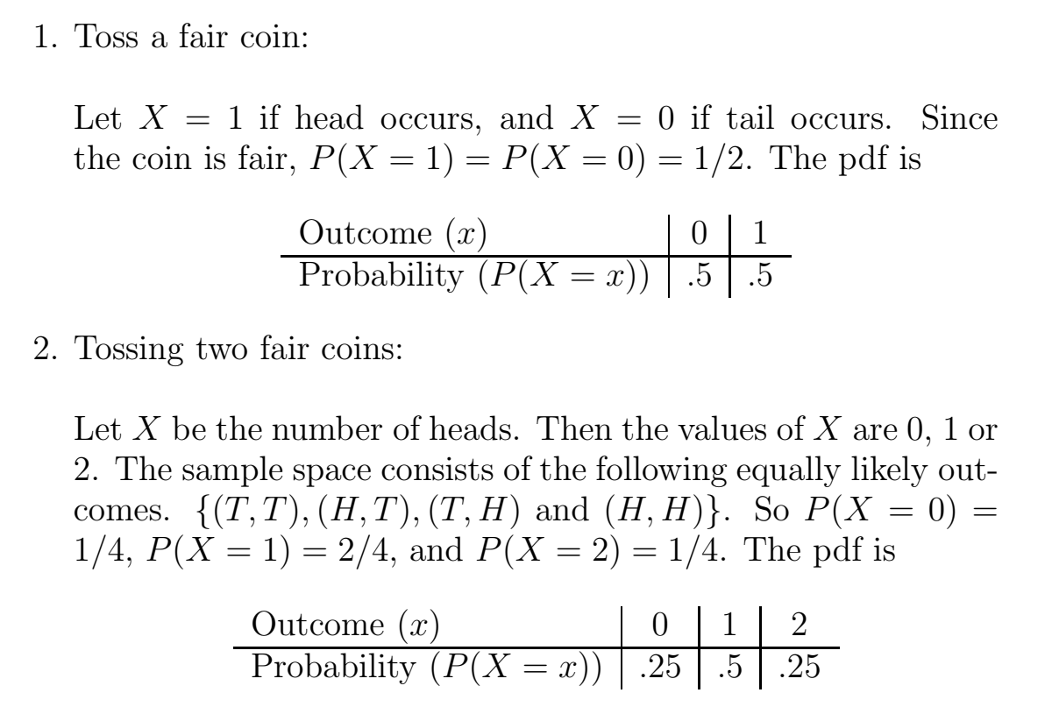
Example

Slide 18

Cumulative distribution function (CDF)
The CDF is defined as the probability that the random variable X is less than or equal to some specified x

Slide 19
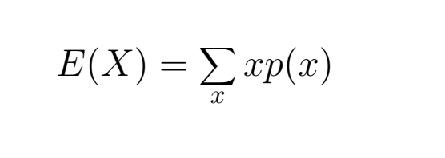
Mean/Expected value of a discrete random variable
Weighted average of all possible values .The weights are the probabilities of respective values of the random variable .

Slide 20
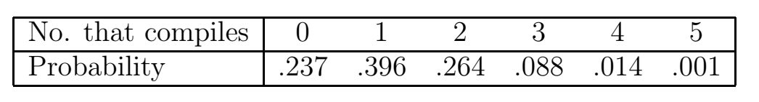
Example
A quarter of the source programs submitted by a certain programmer compile successfully. Each day the programmer writes five programs. The compiling probabilities are:
Calculate the expected number of programs that will compile per day?

Slide 21
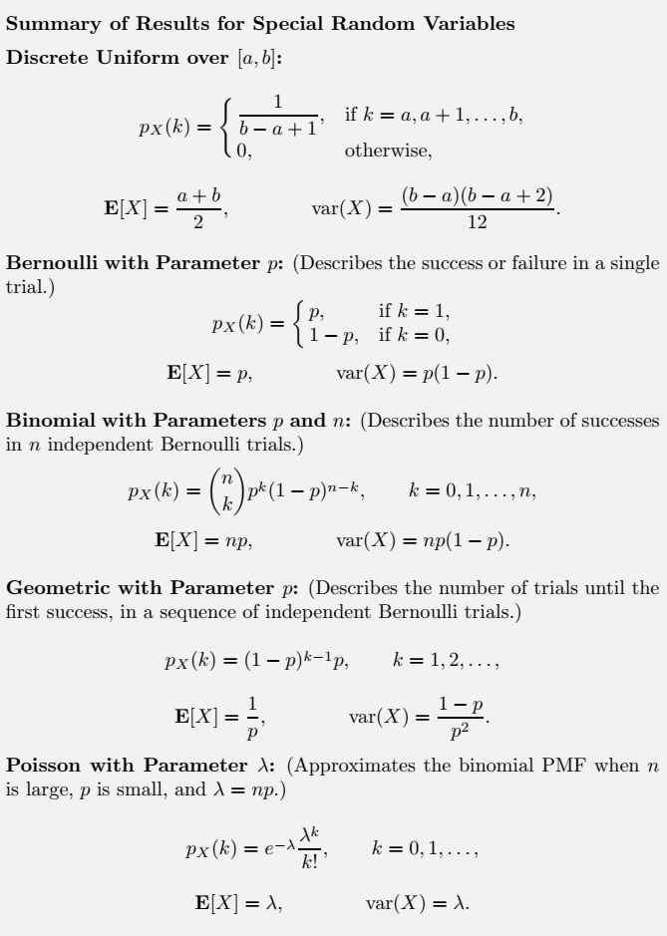

Slide 22
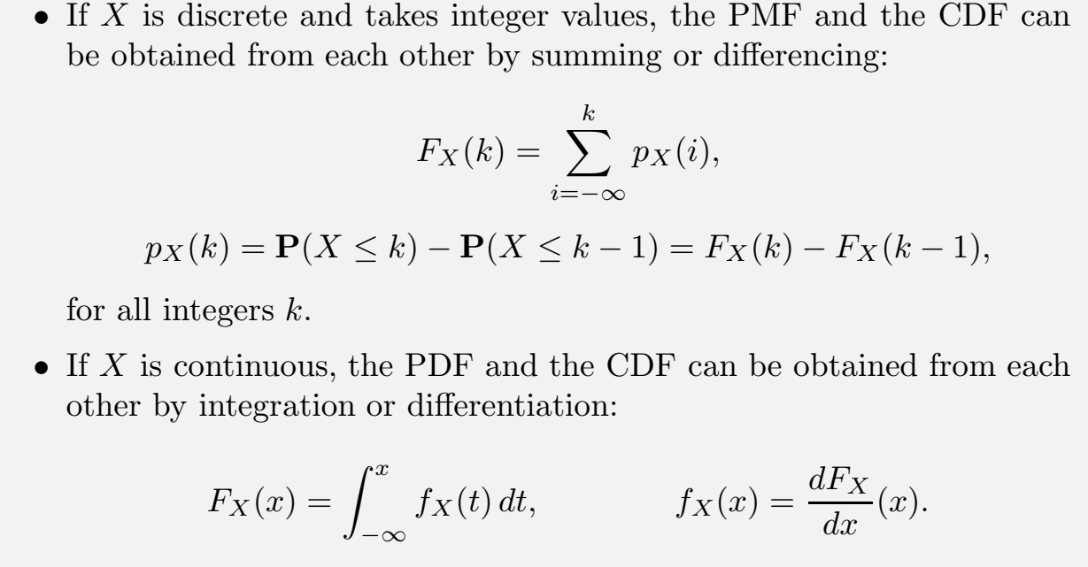

Slide 23
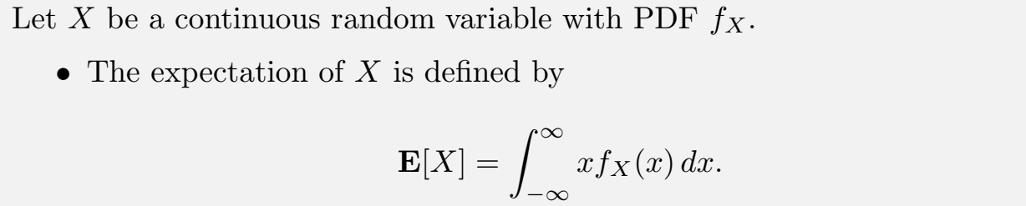

Slide 24
